Slide 1

EXAM PORTAL SYSTEM

Slide 2

TEAM MEMBERS
Divya R
Nivedheetha M
Lakhjindar Singh
Pragya garg
Priyanka R

Slide 3

MENTORED BY
MR. BALAKRISHNA PALLA​
MR. MANMEET JALOTA​
MR. ALLWYN GEORGE

Slide 4
Project Introduction
The online exam portal offers efficient way for students to attend quiz and trainers can add new quiz and evaluate the answers.
It can simplify overall examination management and result in generation activity.

Slide 5

PROBLEM STATEMENT
Offline examination consume lot of time and inefficient.
Time taken to release results in offline exam is also long.
Online examination helps students of schools/ College/ Institutions to offer a quick and easy way to appear for the exam. It also provides the results immediately after the exam.

Slide 6

ADVANTAGES
Examiners get tired checking huge number of answer sheets, hence the system reduces their workload by automating the manual checking process accurately.
The system calculates the score and provides results instantly.
It removes human errors that commonly occur during manual checking.
The system provides an unbiased result.
Thus the system excludes human efforts and saves time and resources.

Slide 7
Types of Users
STUDENT
ADMIN
Registration
Login
Quiz home
Instruction
Quiz page
Admin Login
Admin Home
Profile
Display Quiz
Category section
Quiz addition
· l
MODULES
MODULES

Slide 8
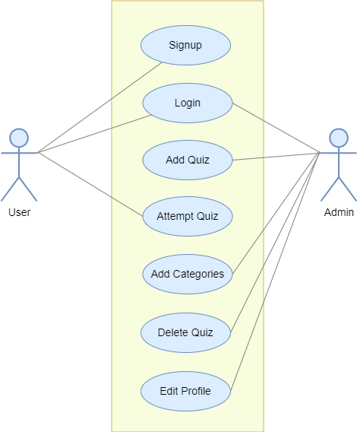
USE ​CASE DIAGRAM

Slide 9
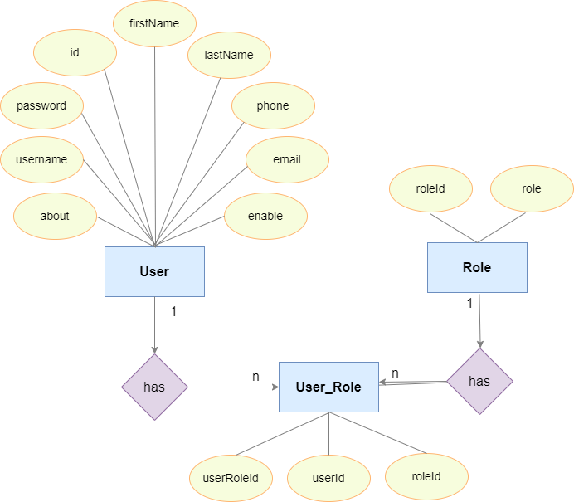
ER-​
DIAGRAM​

Slide 10
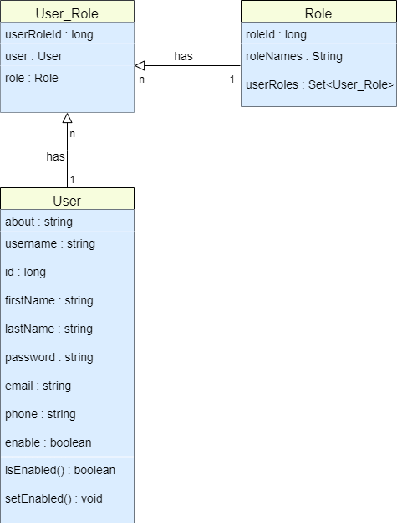
ACTIVITY ​
DIAGRAM

Slide 11

REQUIREMENTS
Windows 10 version.
A browser which supports HTML & JavaScript.
IDE - Eclipse
Visual studio
Oracle developer

Slide 12



USED TOOLS AND TECHNOLOGY​
Frontend- Angular
Backend- Spring Tool
Oracle Database

Slide 13
FRONT END | BACKEND | DATABASE
HTML CSS TYPESCRIPT JAVASCRIPT | JAVA SPRING BOOT | ORACLE

Slide 14

EXECUTION

Slide 15
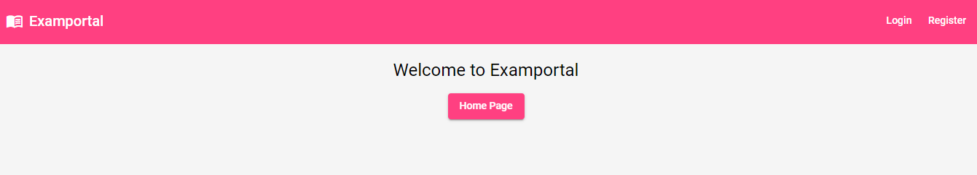
Home page

Slide 16
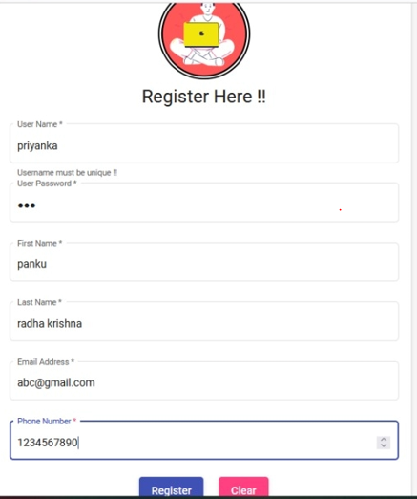
REGISTRATION PAGE

Slide 17
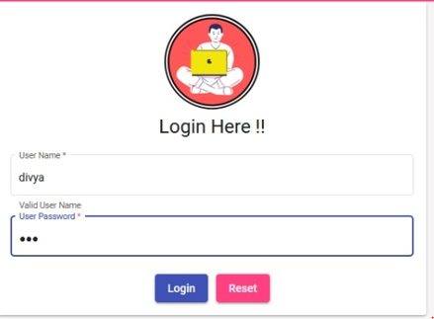
LOGIN PAGE

Slide 18
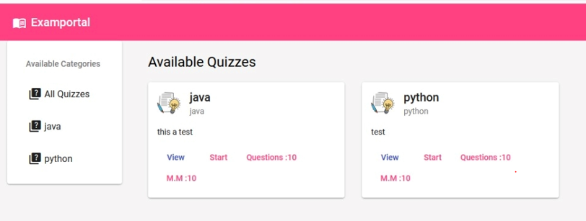
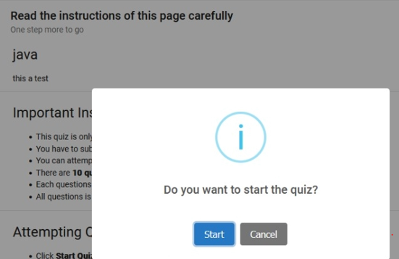
QUIZ HOME PAGE AND QUIZ PAGE

Slide 19
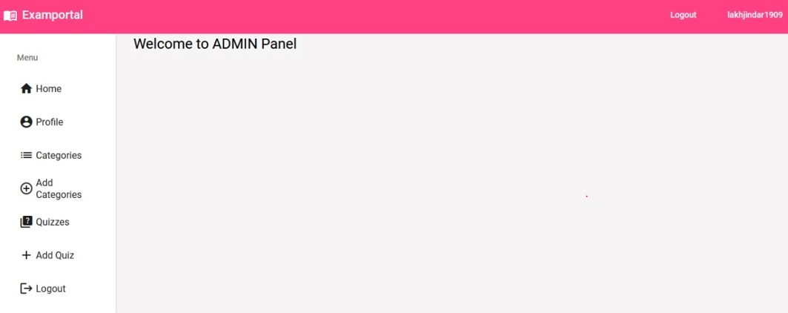
ADMIN PORTAL

Slide 20
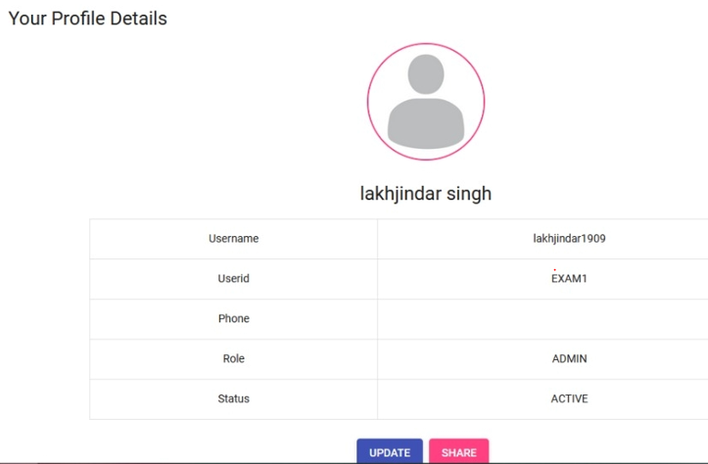
PROFILE DETAILS OF ADMIN

Slide 21
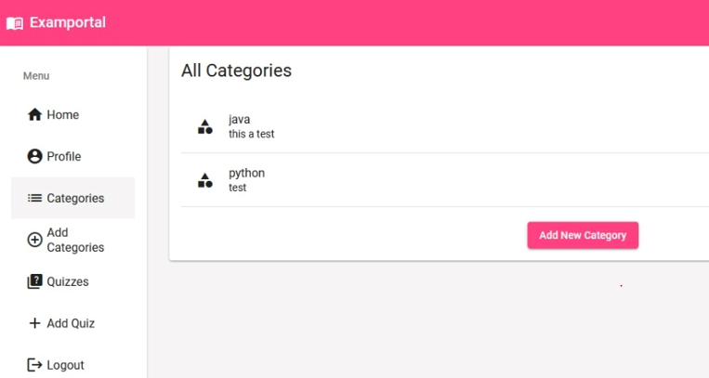
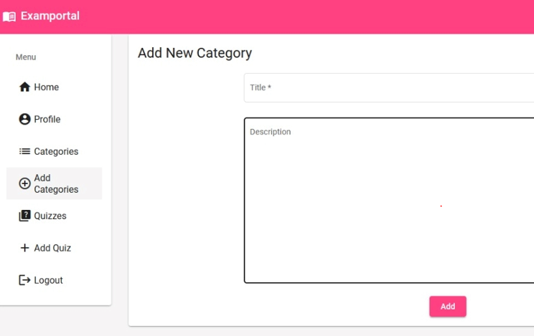
CATEGORY DISPLAY AND ADDITION

Slide 22
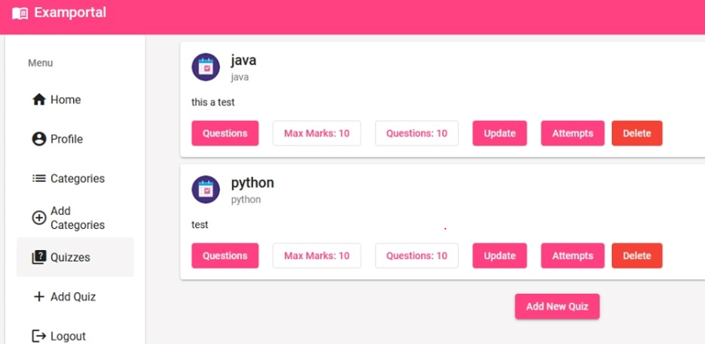
QUIZ DISPLAY

Slide 23
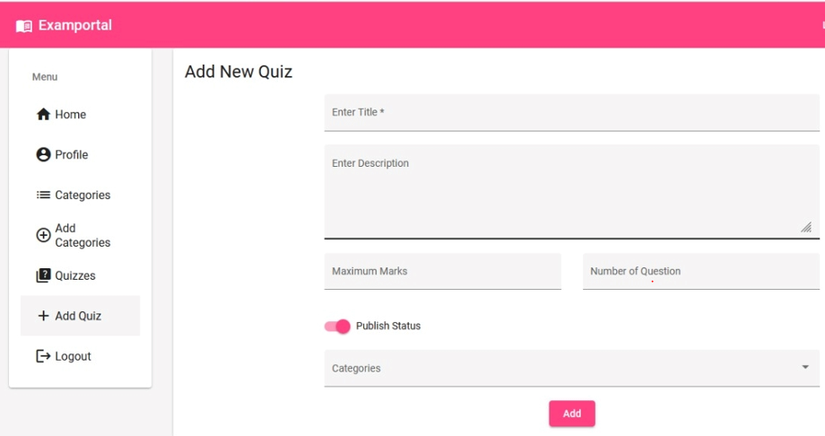
ADD NEW QUIZ

Slide 24


FUTURE ENHANCEMENT​
Add a chat box for student queries
Addition of video lectures for quiz solutions
Create a comment box for student queries.

Slide 25
Finally in the Online exam management system, going with time this is the system we developed to make the process of exam giving and checking easy and available to all and at any time and everywhere.

Slide 26

THANK YOU

